Slide 1
Lincoln County Opioid Data
Lincoln County Opioid Summit for Community Providers
March 7, 2019
Notes:
Good Morning! I'm Genevieve Wesman Lincoln County Health Department Emergency Planner & Surveillance Specialist and this is Jackie Decoster our Public Health Intern. We are going to present a brief overview of the most recent data describing the opioid epidemic as it relates to our community. We aggregated this dated from state and national sources as well as those graciously given to us from our local partner. Disclaimer: this was not all the data that exists. We will discuss how you can share data later in the presentation

Slide 2
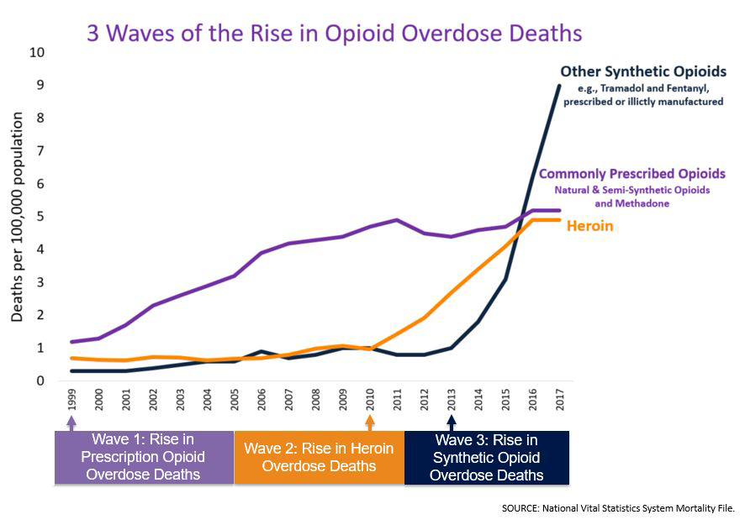
Notes:
Nationally the opioid crisis has been an emerging threat for decades. According to the Center for Disease Control.
Between 1999 and 2017, more than 700,000 people died from a drug overdose
Around 68% of the more than 70,200 drug overdose deaths alone in 2017 involved an opioid.
In 2017, the number of overdose deaths involving opioids (including prescription opioids and illegal opioids like heroin and illicitly manufactured fentanyl) was 6 times higher than in 1999.
On average, 130 Americans die every day from an opioid overdose.
According to the CDC From 1999-2017, almost 400,000 people died from an overdose involving any opioid, including prescription and illicit opioids.
This rise in opioid overdose deaths can be outlined in three distinct waves.
The first wave began with increased prescribing of opioids in the 1990s with overdose deaths involving prescription opioids (natural and semi-synthetic opioids and methadone) increasing since at least 1999.
The second wave began in 2010, with rapid increases in overdose deaths involving heroin.
The third wave began in 2013, with significant increases in overdose deaths involving synthetic opioids – particularly those involving illicitly-manufactured fentanyl (IMF).
So while we are discussing opioids keep this in mind.
Citation: https://www.cdc.gov/drugoverdose/epidemic/index.html

Slide 3
What does the Opioid Epidemic Look like in Lincoln County?

Slide 4
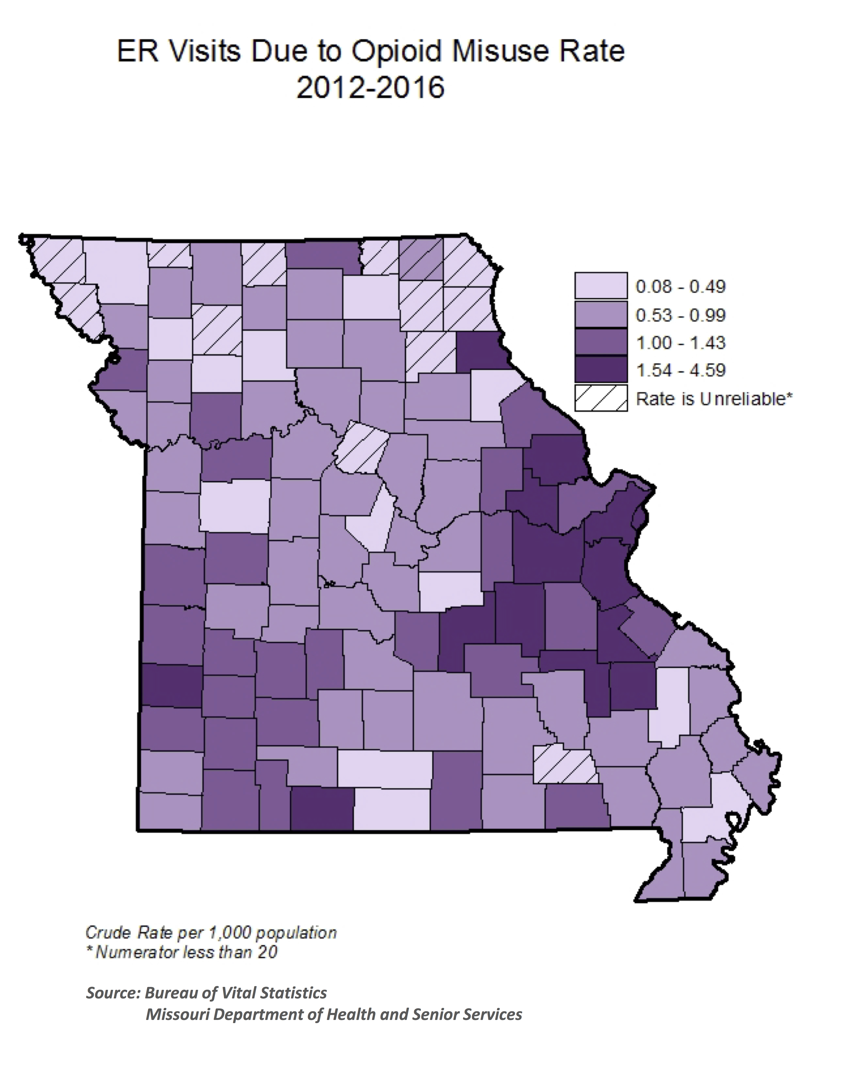
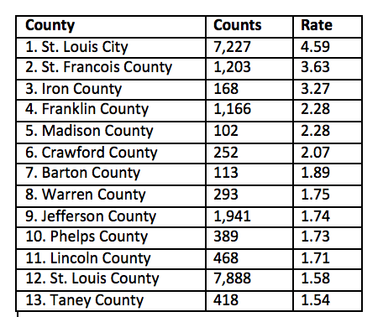
Lincoln County ER visits due to Opioid Misuse rate from 2012-2016 was 1.71 per 1,000 people
Notes:
When we look at Lincoln County's Emergency Room visits due to opioid misuse, the rate from 2012-2016 was 1.71 per 1,000 people. When rates were rank ordered, Lincoln County ranks 11th in the state for highest rate of ER visits due to opioid misuse. This image depicts ER visit rates for Opioid misuse throughout Missouri. I tis important to not that rates are based on the residence of the patient, not the location of the facility from which the patient was discharged. So if a patient listed they lived in Lincoln County but they sought care in another county they will be represented within our county numbers. This is important bc many people receive care outside of Lincoln County.
Citation: https://health.mo.gov/data/opioids/costs.php

Slide 5
Notes:
When we exclude prescription opioids and look exclusively at the rate of emergency room visits for Heroin misuse, our rates are closer to the states rates for the same. In 2017 the state rate for emergency room visits for Heroin Misuse was 5% higher than Lincoln County's rate, but for 2015 Lincoln County Emergency Room visits for Heroin misuse were 32% higher than state rates. It is to be noted that ICD10 codes took effect between 2015 and 2016 and this may partially account for differences in reporting.
Citation: Missouri Department of Health & Senior Services 2019

Slide 6
Notes:
In 2017 there were a total of 99 visits to the ER for misuse of opioids. This number does not reflect those who did not seek care, or refused care/transport from paramedics. This number also reflects that the rate of hospitalizations for opioid misuse in Lincoln County were 25% higher than those of the state. This trend was similar in previous years with 2015 being our highest rate of emergency room visits due to opioid misuse at 30% above the state rate.
Citation: Missouri Department of Health & Senior Services 2019

Slide 7
Non-Heroin misuse accounted for 80% of all opioid misuse Emergency Room visits in Lincoln County, for the period from 2013-2017
Notes:
In summary when you look at those who were seen at the ER for misuse of Heroin verses non-heroin misuse, non-heroin misuse cases account for 80% of the total cases seen at the ER Related to opioids from 2013-2017
Citation: Missouri Department of Health & Senior Services 2019

Slide 8
Hospital care
Notes:
We combined ER visits and inpatient hospitalizations, to evaluate the total number of individuals seeking care at hospitals. When we did this rate for hospital visits for opioid misuse by Lincoln Couty Residents is 25% higher than the state rate for the period between 2013 to 2017.
Citation: Missouri Department of Health & Senior Services 2019

Slide 9
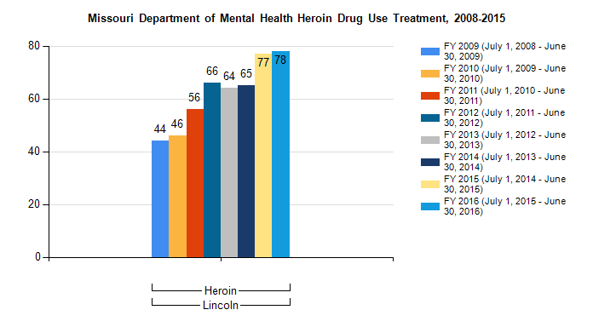
Between July 1, 2015 & June 30, 2016 78 people were treated for substance abuse disorder due to Heroin from Lincoln County.
Lincoln County Substance Use Treatment
Notes:
Between July 1 2015 & June 30, 2016 78 people were treated for substance abuse disorder due to Heroin from Lincoln County. A total of 496 individuals were treated for substance use related to heroin from July 2008-June 2016. This number does not reflect those who sought treatment for other opioid substance use disorders, or those who did not receive care, or sought treatment at private substance use treatment facilities.
DMH data only includes DMH consumers. Based on the 2017 NSSATS – National Survey of Substance Abuse Treatment Services (a survey that goes to all treatment service facilities) approximately 73% of all Missouri clients were served through services provided by DMH facilities. The remainder received services from for-profit facilities.
Citation: https://seow.dmh.mo.gov/TREATMENTADA/TREATMENTADAIndicators.aspx?PATH=Indicators&SID=NEW

Slide 10
Pregnancy & Youth
Notes:
So what does opioid use look like for Lincoln County Mothers and Children.

Slide 11
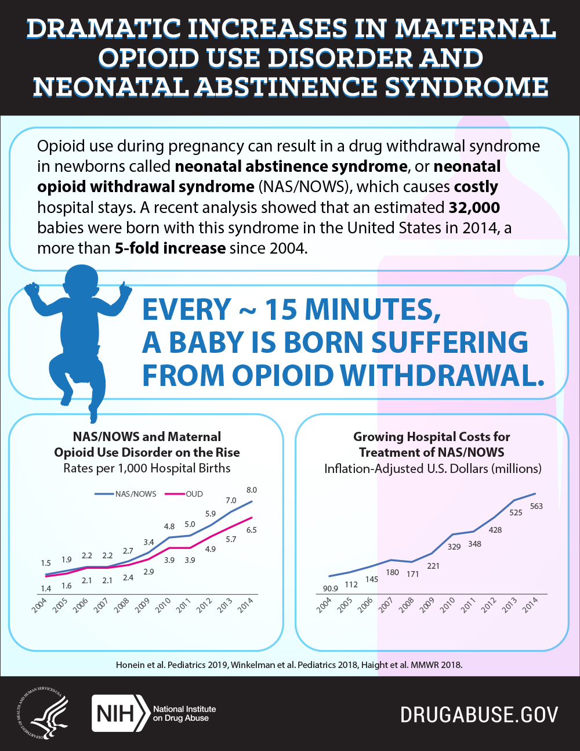
Opioid Use & Pregnancy ___________
Notes:
Opioid use during pregnancy can result in a drug withdrawal syndromes in newborns called Neonatal Abstinence Syndrome. NAS is a group of conditions caused when a baby suffers withdrawal from certain drugs they are exposed to in the womb. Children born with NAS have increased hospital stays, negative health outcomes, and higher treatment costs.
Nationally the incidence of children born suffering from NAS, has increased to where every 15 minutes a baby is born suffering from opioid withdrawal.
Citation: https://www.drugabuse.gov/related-topics/trends-statistics/infographics/dramatic-increases-in-maternal-opioid-use-neonatal-abstinence-syndrome

Slide 12
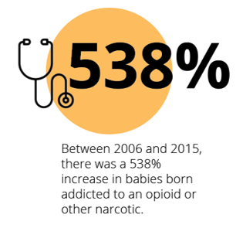
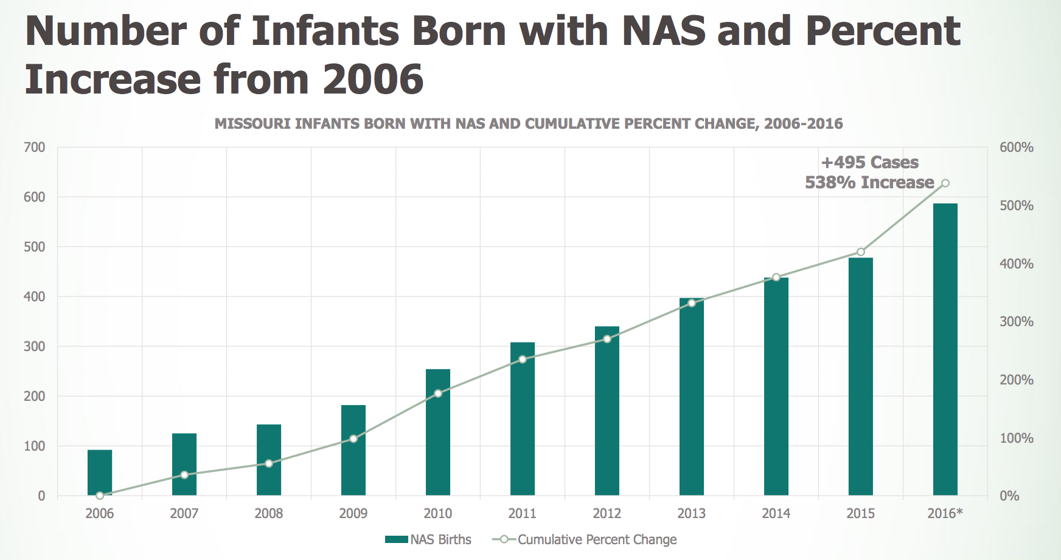
Missouri Neonatal Abstinence Syndrome
Notes:
For the state of Missouri babies born addicted to opioids has increased 538% between 2006 and 2015.
The NAS definition here includes all Missouri resident newborns with an ICD-9 code of 779.5 or 760.72 appearing anywhere on the newborn record or a record where the admission date was within the patient’s first year of life between 2011 and 2015.
Citation: https://www.mhanet.com/mhaimages/opioid/NAS_Research.pdf
Citation: https://www.drugabuse.gov/related-topics/trends-statistics/infographics/dramatic-increases-in-maternal-opioid-use-neonatal-abstinence-syndrome

Slide 13
Lincoln County Neonatal Abstinence Syndrome
Notes:
These rates are mirrored at the county level. Lincoln County has seen a marked rise in children born with NAS from 5.52 per 1,000 births in 2011 to 36.29 per 1,000 births in 2016. This translates to a more than 500% increase in the incidence of babies born with NAS in the county since 2011.
Citation: Missouri Department of Health & Senior Services 2019

Slide 14
Perceptions of Drug Use in School-Age Children
26.8% of Lincoln County Youth believe that it would be easy to get prescription drugs that were not prescribed to them
11.6% of youth believe that there is a 'slight' or 'no risk at all' when misusing prescription medications
Most youth reported that they get prescription drugs from a friend or family member
Notes:
If we look at the data taken from the 2018 Missouri Student Survey from Lincoln County the perception of access to drug is extremely high among Lincoln County school age children, while the perception of risk is low. 26.8% of Lincoln County Youth believe that it would be easy to get prescription drugs that were not prescribed to them. 11.6% of youth believe that there is a 'slight' or 'no risk at all' when misusing prescription medications, and most youth reported that they get prescription drugs from a friend or family member.
Citation: https://dmh.mo.gov/docs/ada/mss2018-lincoln.pdf

Slide 15
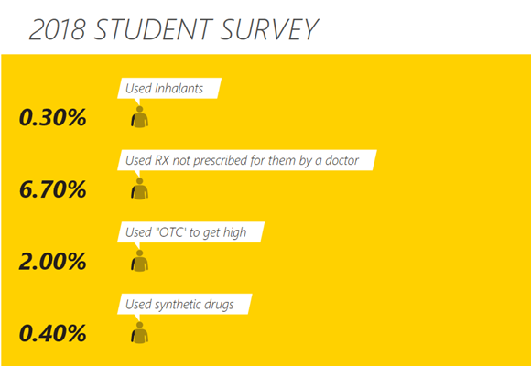
2018 Missouri Student Survey Lincoln County
Notes:
When students from that same survey were polled, less than 1% combined had used either inhalants or synthetic drugs in the past year to get high. While 2% stated they had used over the counter drugs to get high, and nearly 7% of the students polled said they had used a prescription not prescribed for them by a doctor.
OTC: over the counter drugs (Barbiturates, benzodiazepine, cold medicine)
Citation: https://dmh.mo.gov/docs/ada/mss2018-lincoln.pdf

Slide 16
Notes:
Additionally the rate of students disciplined for drugs went up from the 2014-15 school year, and remained around 1% for both following school years. The rate of students disciplined for drugs was consistently higher all three years that we had data on, than disciplinary actions related to alcohol.
School discipline involving drugs: 12 in 2014-2015, 30 in 2015-2016, 30 in 2016-2017
School discipline involving alcohol: <10 in 2014-2015, <10 in 2015-2016, <10 in 2016-2017
Citation: https://dmh.mo.gov/docs/ada/mss2018-lincoln.pdf

Slide 17

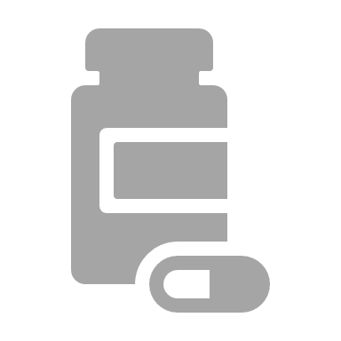
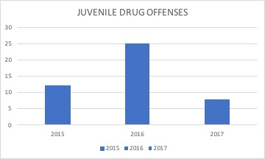
Juvenile Drug Offenses
Notes:
The 2018 Status Report on Missouri's Substance Use and Mental Health identified there were <10 juvenile drug offenses in 2015, 25 in 2016, and 12 in 2017 in Lincoln County. As shown here there was a marked increase in 2015.
Citation: https://dmh.mo.gov/ada/countylinks/documents/indicator-lincoln.pdf

Slide 18
Opioid Use & the Law
Notes:
Now I will talk about opioid use and the law.

Slide 19
Law Enforcement
In 2017 there were 242 drug-related arrests in Lincoln County
In 2016 there were less than 10 Drug related fatalities and injuries in Lincoln County.
Notes:
So in 2017, there were 242 drug related arrests in Lincoln County
In 2016, there were less than 10 drug related motor vehicle fatalities and injuries in Lincoln county.
Citation: https://dmh.mo.gov/docs/ada/commprofile2018-lincoln.pdf

Slide 20
At What Cost?
Naloxone
Staff time (Police, LCAD, Fire)
Medical Cost
Human Cost
Notes:
After you consider all that information, what does the opioid epidemic cost Lincoln County. In this section, I will talk about the medical costs, cost of narcan/naloxone, staff time cost, and of course the human cost.

Slide 21
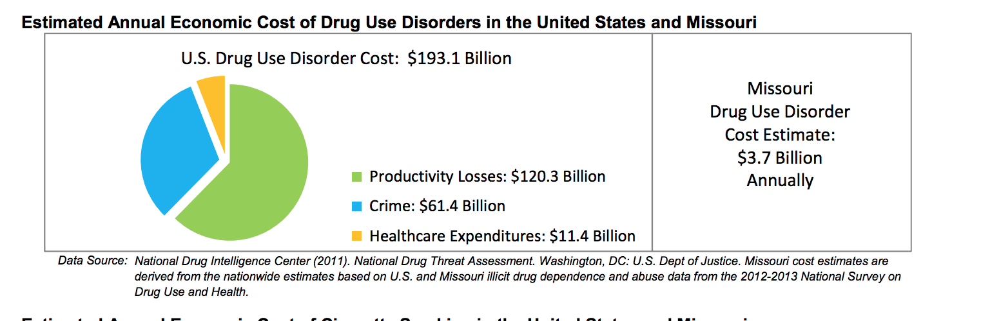
Medical Costs
General cost for ER visit:
The average cost to treat overdose patients admitted to hospital intensive care units climbed from $58,517 in 2009 to $92,408 in 2015—a 58 percent hike, according to a 2017 study that analyzed 162 hospitals in 44 states.
Notes:
It is estimated that the nationally, the U.S. spent more than $193 billion on drug use disorders annually between 2012& 2013.
$120 billion in lost productivity
$61 billion spent on crime related to drug use disorders
$11 billion in health care expenditures
In missouri the drug use disorder cost estimate was $3.7 billion annually
Additionally, the average cost to treat an overdose patient admitted to the hospital intensive care unit rose from $58,517 in 2009 to more than $92,000 in 2015.
Citation: https://dmh.mo.gov/docs/ada/statusreport2015-c01.pdf

Slide 22
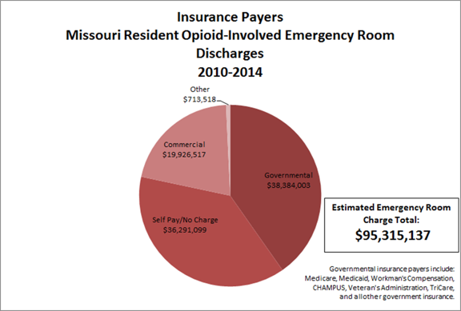
Medical Costs
Notes:
Then from this graph it shows that in Missouri the estimated emergency room charge total was $95 million
Citation: https://clphs.health.mo.gov/lphs/conferencematerials/OpioidDataSharing.pptx

Slide 23
Narcan In 2018, Lincoln County Ambulance District (LCAD) responded to 64 calls on which Narcan was given, totaling 102 prefilled syringes.
What is Narcan?
Narcan or Naloxone is a medication that suspends the effects of an opioid overdose until emergency responders arrive. It works by blocking the opiate receptor sites and reverses the effects of an overdose, restoring a normal breathing pattern.
How much does Narcan cost Lincoln County?
LCAD carries 2mg/2ml of Narcan. Cost is $27.43 per syringe. Total cost in 2018 for Narcan for the ambulance district was $2,797.86.
Notes:
Now onto the costs for Narcan in Lincoln County. First off
What is Narcan?
Narcan or Naloxone is a medication that suspends the effects of an opioid overdose until emergency responders arrive. It works by blocking the opiate receptor sites and reverses the effects of an overdose, restoring a normal breathing pattern.
How much does Narcan cost Lincoln County?
LCAD carries 2mg/2ml of Narcan. Cost is $27.43 per syringe. Total cost in 2018 for Narcan for the ambulance district was $2,797.86.
Narcan In 2018, Lincoln County Ambulance District (LCAD) responded to 64 calls on which Narcan was given, totaling 102 prefilled syringes.
This translates to 64 lives that may have been saved.
Citation: Lincoln County Ambulance District 2018

Slide 24
Staff Time Cost
Lincoln County Sheriff’s Office:
Greater than a 1000 hours spent each month responding to overdose calls.
Lincoln County Ambulance District:
Spent 4,820 minutes on Narcan calls. Or 80.5 hours of EMS time for a 2 person crew.
Notes:
Other costs attributed to opioid substance abuse disorders in Lincoln County include staff time for our response agencies.
Lincoln County Sheriff’s Office:
Greater than a 1000 hours spent each month responding to overdose calls.
Lincoln County Ambulance District:
Spent 4,820 minutes on responding to overdose calls. Or 80.5 hours of EMS time for a 2 person crew.
Citation: Lincoln County Ambulance District 2018
Lincoln County Sherriff's Department 2018

Slide 25
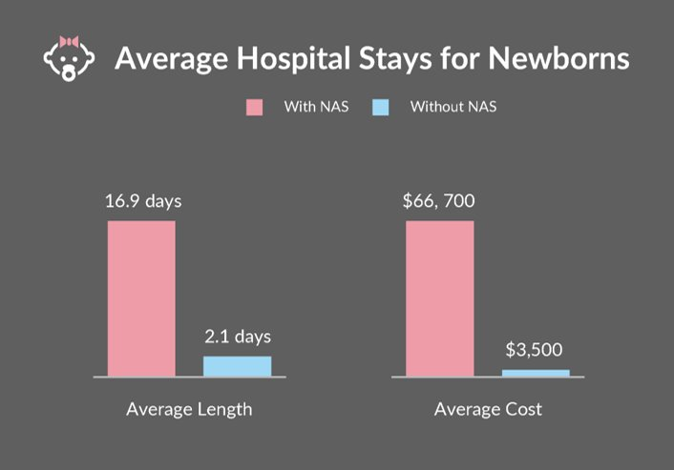
Cost of NAS
Notes:
Between 2009 and 2012, NAS-related charges increased from $732 million to nearly $1.5 billion . The average stay for a newborn born with NAS versus without is 2 weeks longer, and costs more than $60,000 on average more per child affected. This does not account for the cost of care to the mother. Since this data is from 2012 we can assume that this amount has increased proportionally over time.
Citation: Drugabuse.com

Slide 26
Human Cost
Notes:
Then of course there is the human cost of the epidemic. This data doesn't come close to representing all the lives that are touched due to opioid substance abuse disorders in our county.

Slide 27
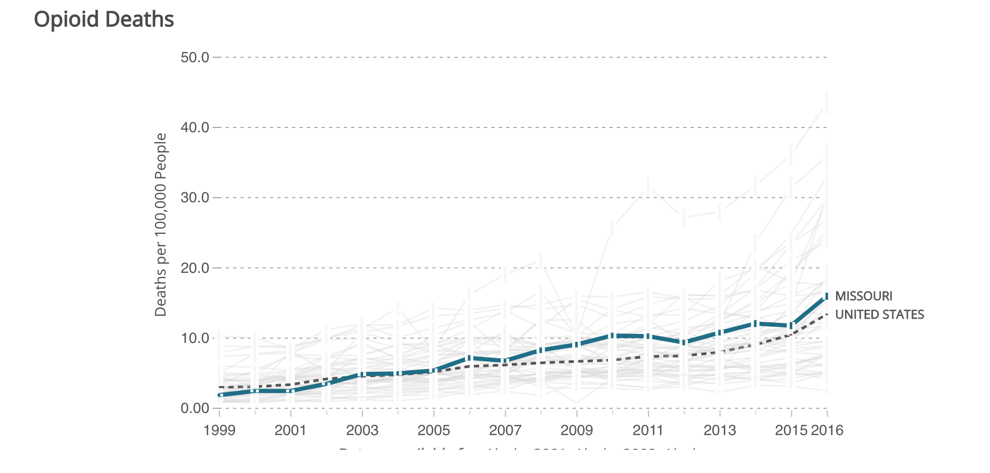
Missouri Opioid Deaths trend from
1999-2016
Notes:
As you can see from this image, there has been a steady trend upward in the number of deaths due to opioids in Missouri since 1999.
Citation: https://health.mo.gov/data/opioids/costs.php

Slide 28
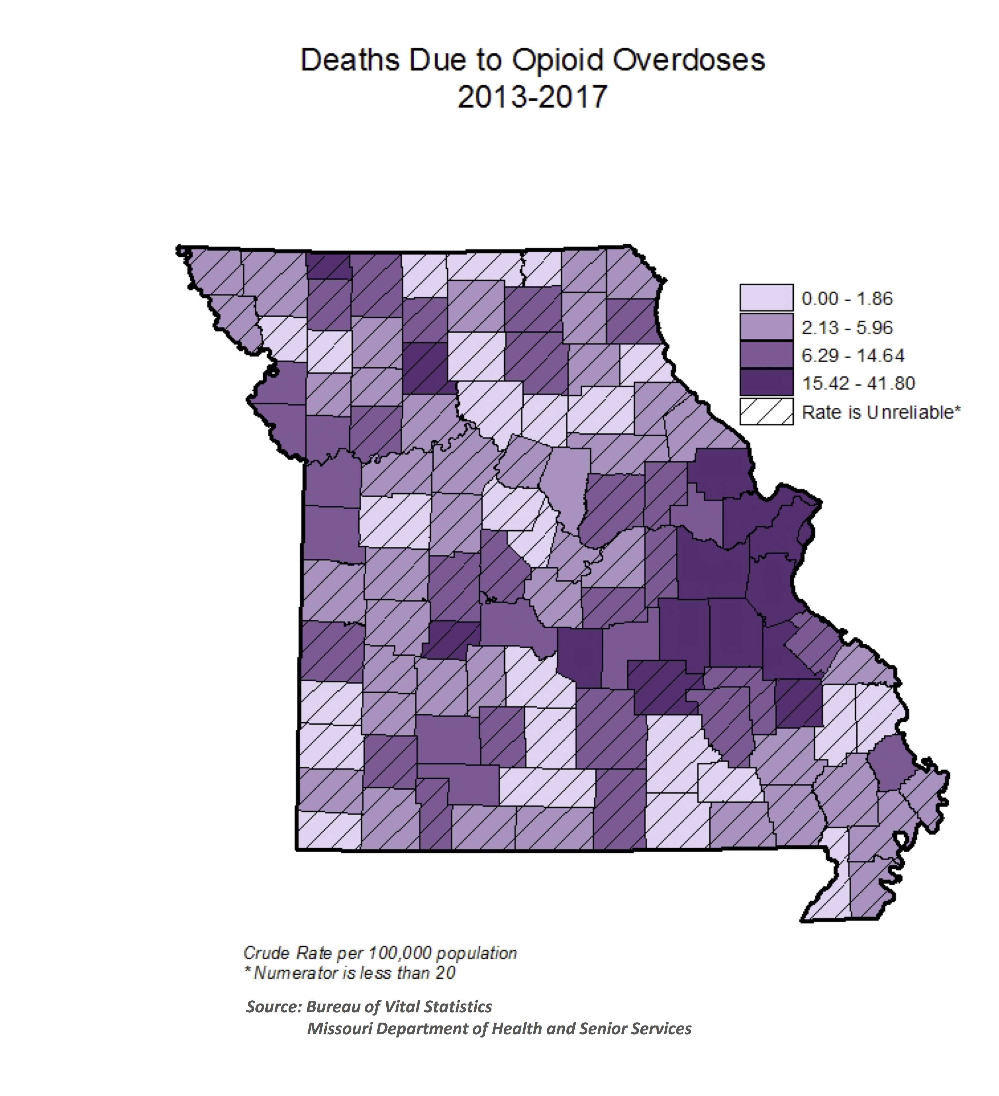
Opioid Deaths in Missouri by County
Lincoln County Deaths due to Opioid Overdoses from 2013-2017, rate is 17.88 per 100,000
Notes:
Here you can see all Missouri counties ranked based on their 2013-2017 crude death rate (per 100,000 population) due to opioid-involved overdoses.
The rate of Deaths due to Opioid Overdoses from 2013-2017 is 17.88 per 100,000. Lincoln County ranked 7th in the state for Deaths due to opioid overdoses.
Citation: https://health.mo.gov/data/opioids/pdf/opioid-dashboard-slide-3.pdf

Slide 29
Rate of Opioid Overdose Deaths of Lincoln County
Notes:
The rate of opioid deaths for Lincoln County residents has increased steadily between 2013 and 2017 and maintained a higher rate than the states rate during that same time period. In 2017, Lincoln County's rate was 37% higher compared to the rates for Missouri.

Slide 30
Summary
Our residents are dying.
Lincoln County mothers, babies, and youth are being affected every day.
Continued trend upward.
Notes:
In summary
Our residents are dying.
Lincoln County mothers, babies, and youth are being affected every day,
& there is a continued trend upward.

Slide 31
Have Any Data to Share?
We rely on other agencies to share information
Robust data sets aid in the creation of informed policy and decision making
Please let us know if you are aware of any data that can aid in identifying ways to curb the opioid epidemic in our community
Notes:
Do you have any data to share?
We rely on other agencies to share information
Robust data sets aid in the creation of informed policy and decision making
Please let us know if you are aware of any data that can aid in identifying ways to curb the opioid epidemic in our community

Slide 32

Contact Information
Genevieve Weseman, MPH
Lincoln County Health Department
Emergency Planner & Surveillance Specialist
Phone: (636)-528-6117 Ext. 408
Genevieve.Weseman@lchdmo.org
www.lchdmo.org
Jackie Decoster, MPH Candidate
Lincoln County Health Department
Public Health Intern
Phone: (817)-675-8889
Decosj@lchdmo.org
Notes:
If you have any data to share or want to contact us for any additional information please feel free to contact Genevieve or I.

Slide 33
Questions?

Slide 34

Thank you!

